Slide 1

ASP.NET WebAPI RESTful Web Services
Йордан Йорданов
Chief Technical Officer
yyordanov@iboris.eu
http://iboris.eu/

Slide 2
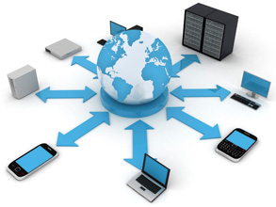
Software applications get connected
THE PROBLEMS:
Various devices
Various technologies
Various protocols
Various networks:
Internet
Local networks
VPN
Network Security constraints

Slide 3
Software applications get connected
PROTOCOLS & HISTORY
RPC (Remote Procedure Call) – introduced in the 1970s
SOAP (Simple Object Access Protocol) – introduced in 1998 by Microsoft; W3C standardization in 2003
REST (Representational State Transfer) – introduced in 2000; no standards
OData (Open Data Protocol) – introduced in 2007 by Microsoft; international standard 2015
Other – Web Sockets / TCP Sockets / P2P etc.

Slide 4
Why REST?
REST
PROs
Simple – uses pure features of HTTP
Performant
Portable
Reliable
Scalable
Cacheable
Stateless
CONs
No standards
SOAP
Biggest PROs
W3C standard
Discoverability (WSDL/UDDI)
Message validation (XSD)
Biggest CONs
Huge network footprint
Very complex standard
Incompatible implementations of the standard

Slide 5
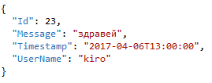
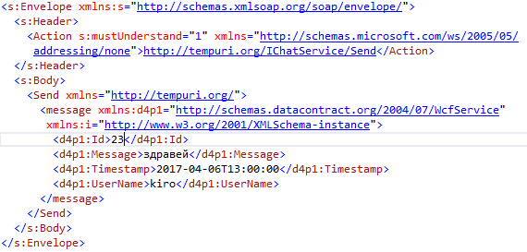
REST vs. SOAP
REST
URL: http://localhost:14465/api/Chat/23
Method: PUT
Message (JSON) – 113 bytes
SOAP
URL: http://localhost:14465/ChatService.svc
Method: POST
Message (XML) – 675 bytes

Slide 6
ASP.NET WebAPI
RESTful Web Services
Resource – uniquely identified by URL
Operation – HTTP Method:
GET – get the resource
POST – insert a new resource
PUT – update (full) a resource
DELETE – delete a resource
Data for the request:
GET – via URL query string
all other methods – via Request Body
Data Format – defined by the “Content-Type” HTTP Header
ASP.NET WebAPI
ApiController responds to the URL
HTTP Method is mapped to an Action in the ApiController by naming convention
Data – structure is represented by classes (contracts). Deserialization based on the “Content-Type”

Slide 7
DEMO
ASP.NET WebAPI basics

Slide 8
WebAPI Extensibility
Filters
Types:
IAuthenticationFilter
IAuthorizationFilter
IActionFilter
IExceptionFilter
Applied over:
Entire application
Controller
Action
Message Handlers
Can modify Request / Response
Can interrupt the pipeline
WebAPI Pipeline
Request
Response
Server
Message Handlers
Routing
Route Message Handlers
Filters
Controller Action

Slide 9
DEMO
Validation | Authentication | Tracing

Slide 10
Real-life scenarios
Web Applications development
Mobile Apps
Integration between software systems
Architectural approaches for large enterprise systems
SaaS services (Software as a Service)

Slide 11
DEMO
Web Application
ASP.NET MVC + ASP.NET WebAPI

Slide 12
Advanced topics
OAuth – Open Authentication
OWIN and custom hosting
Customizing:
ControllerFactory
Formatters
Serializers/Deserializers
Routing
Dependency Injection
Versioning
Working with files
Documentation (simulate WSDL)

Slide 13
Resources
WebAPI https://docs.microsoft.com/en-us/aspnet/web-api/
WCF https://msdn.microsoft.com/en-us/library/ee354181.aspx
OData http://www.odata.org/
Wikipedia
SOAP https://en.wikipedia.org/wiki/SOAP
OData https://en.wikipedia.org/wiki/Open_Data_Protocol
REST https://en.wikipedia.org/wiki/Representational_state_transfer

Slide 14
demos and presentation available on https://github.com/yyordanov/ITForumApr2017 Q & A
Йордан Йорданов
Chief Technical Officer
yyordanov@iboris.eu
http://iboris.eu/

Slide 15
TITLE
Content

Slide 16
TITLE
SUBTITLE
Bullet List

